Slide 1
Landover Hills- Maryland Open Data Portal
Zulykath Lucero, Shishir Poreddy, Ruth Ayele, Arafat Bhuiyan, Avindra Mahesh, Daniel Araj
Notes:
Daniel

Slide 2
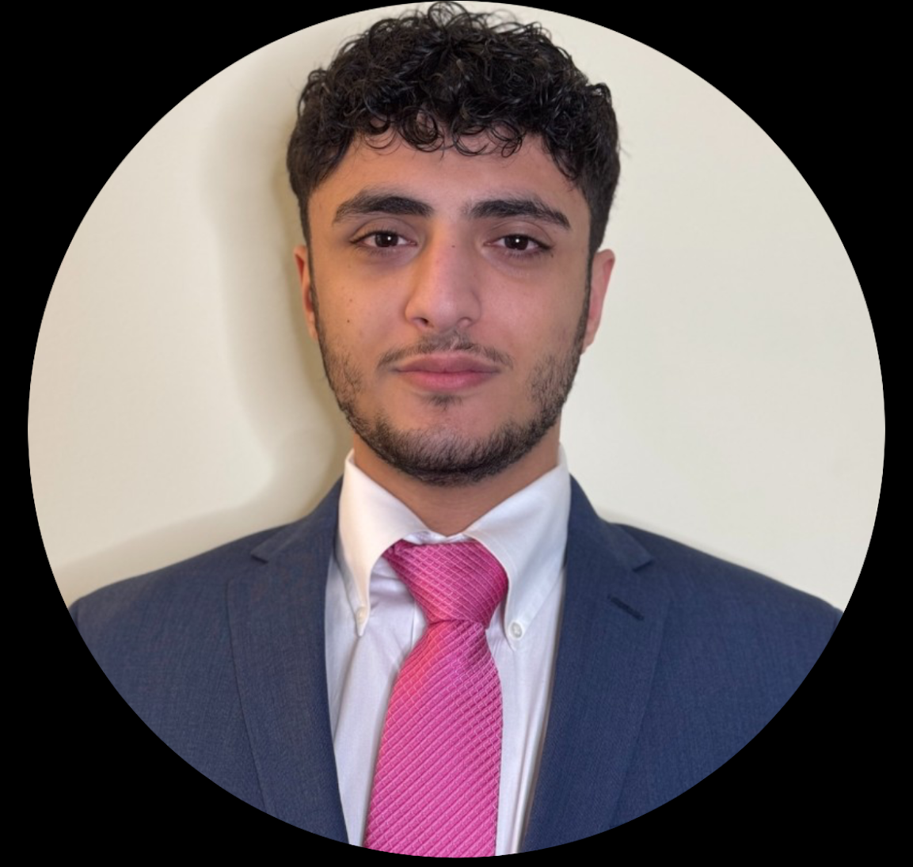





Team Members
Data Dashboard Developer:
Shishir Poreddy
Requirements Coordinator:
Ruth Ayele
Project Manager:
Daniel Araj
Data Analyst:
Zulykath Lucero
Data Analyst:
Arafat Bhuiyan
Research Specialist:
Avindra Mahesh
Notes:
Daniel

Slide 3
Agenda
What we will be going over today:
Introduction & Project Context
Project Requirements
Preview of Deliverables
Technical Challenges
Recommendations
Notes:
Daniel

Slide 4
Introduction & Project Context
The Problem:
The town of Landover Hills is looking to contribute to the Maryland Open Data Portal with their municipal data
Our client wants to develop a plan for how the town can collect, format, and submit local data into the portal
The town of Landover Hills had limited personnel, funding, and data infrastructure in place
Notes:
Avindra

Slide 5
Project Requirements
The Solution:
Original Requirements
Data Needs Report – A summary of the specific data categories requested by the state for municipal contributions.
Municipal Data Assessment – An inventory of existing data available in Landover Hills and an analysis of any gaps.
Best Practices Review – A comparative analysis of how other municipalities have successfully contributed to the portal.
Implementation Plan – A step-by-step guide for Landover Hills to format, organize, and submit its data to the Maryland Open Data Portal
Final report and presentation to stakeholders, including recommended next steps
Requirement Changes
Added the creation of a data dashboard for the client to display on their website
Notes:
Avindra

Slide 6
Data Needs Report
Administrative
Budget
Business & Economy
Demographic
Education
Environment
Health
Planning
Public Safety
Transportation
Key categories selected based on their relevance, feasibility, and potential benefit to the Town of Landover Hills' open data initiatives:
Notes:
Ruth

Slide 7
Municipal Data Assessment
Key Gap
Lack of Structured Data → Portal incompatibility, limited usability
Existing Data:
FY 2024 & FY 2025 Budget Data
Identified Data Assets:
Public Amenities (parks, EV stations)
Infrastructure (power outages, red lights)
Business & Commerce (retail, restaurants)
Education (public, private, and higher learning)
Community institutions (churches)
Medical Facilities
Feasible Opportunities for Data Expansion
Infrastructure/Public Safety Data
Permitting/Licensing Information for Businesses
Education
Geospatial Data
Notes:
Ruth

Slide 8
Opportunities for Data Expansion
Data Domain | Current State | Proposed Improvements
Infrastructure | Red light and speed camera locations listed | Develop a structured dataset including coordinates and installation information
Business | No centralized registry of businesses | Create a business database with name, type, address, establishment date, and licensing information
Education | School names and addresses are listed | Create a dataset with name, address, website, phone number, coordinates, and type (e.g. public/private, K-12)
Geospatial | Many data categories lack geotagging; some is powered externally (Pepco, Open Charge Map) | Convert to iMAP

Slide 9
Implementation Plan
Uploading A Data File
Create Dataset:
Click Create > Dataset > Add Data
Upload file (drag-and-drop or browse)
Format Data:
Use the Data Preview tool to edit columns and types
Fill Out Metadata Fields:
Title: Clear and public-friendly
Description: Source, purpose, update process
Tags: Use keywords related to agency/topic
License: Typically Public Domain
Contact Email: Mandatory for public inquiries
Update Frequency: Monthly, quarterly, etc
Jurisdiction: Usually "State of Maryland"
Time Period: Enter time span (e.g., FY 2020–2023)
Method | Pros | Cons
Uploading a Data File | Simple & Supports Multiple Data Types | Manual Updates Required
Importing from URL | Easy to Connect to External Data | Sensitive to Formatting Issues
Socrata Gateway | Automates work & Compatible w/ many formats | Most Complex Method
Linking External Source | Offers Quick Spreadsheet Downloads | Less Functionality
Notes:
Ruth

Slide 10
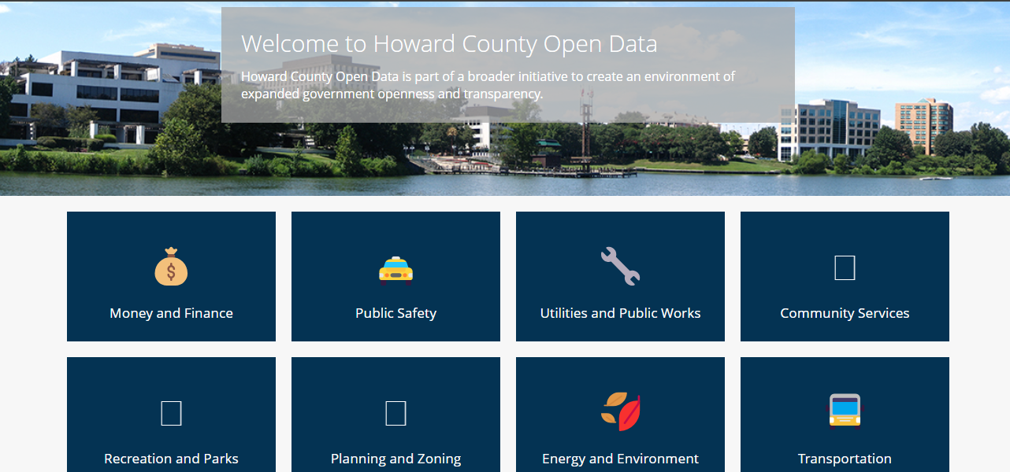
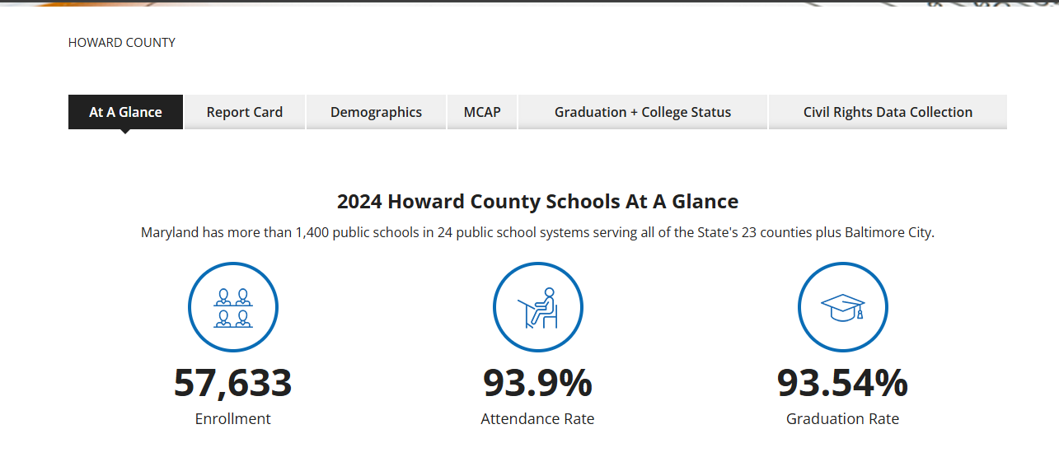
Best Practices Review
Howard County’s portal is a model of clear organization and public access.
Data organized by major categories: Money & Finance, Public Safety, Utilities, Community Services, Parks, and Environment, etc
Detailed topic pages: For example, the Education section provides enrollment, attendance, and graduation rates at a glance.
Comprehensive metadata: Report cards include data descriptions, last updated dates, and data providers.
Good Practices: Use of machine-readable formats (CSV, JSON), metadata documentation, geographic tagging, regular updates, public dashboards
Key takeaway: clear categories, summary stats, update details, and good data practices all make a huge difference in improving transparency and public engagement.
Notes:
Arafat

Slide 11
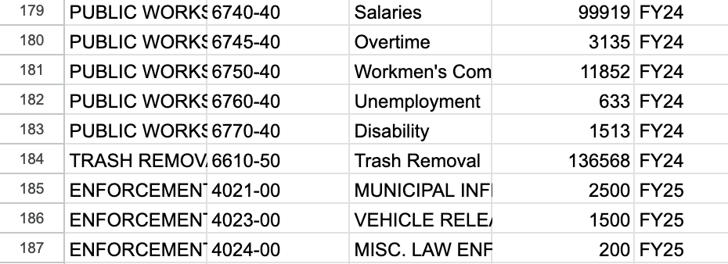
Data Dashboard
Landover Hills Budget Data Document:
This Document contains all the budget data from Fiscal Year 2024 and 2025.
This document serves as the live data feed for the dashboard, any updates here automatically refresh all visualizations.
Plan to implement FY26 budget data soon.
Work with Ms.Diaz to implement dashboard into current website.
Notes:
Shishir

Slide 12
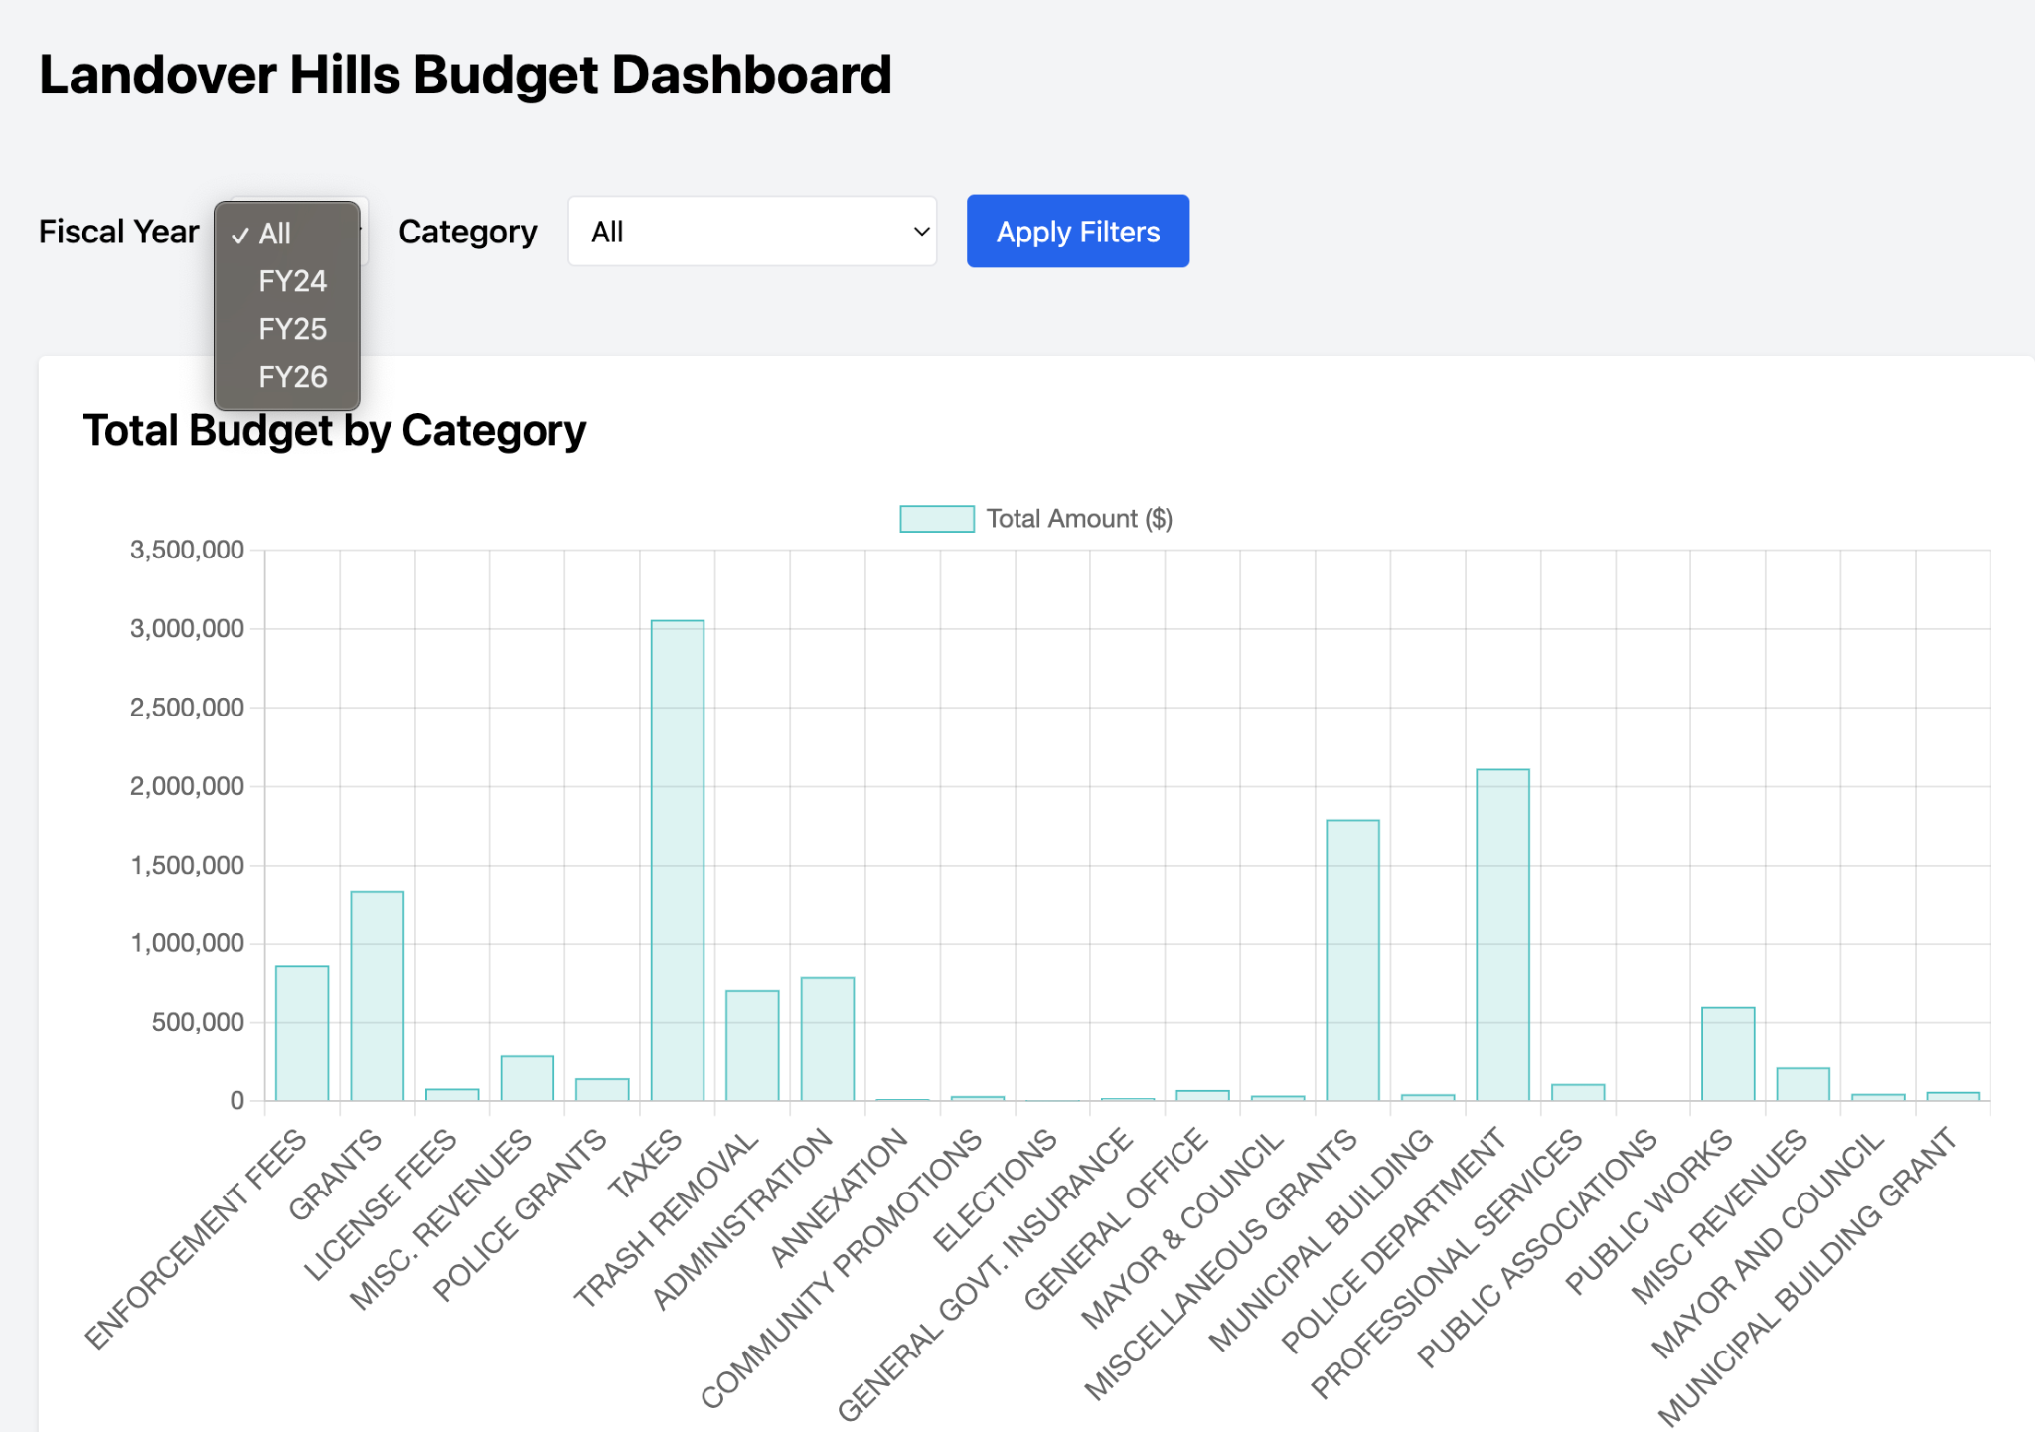
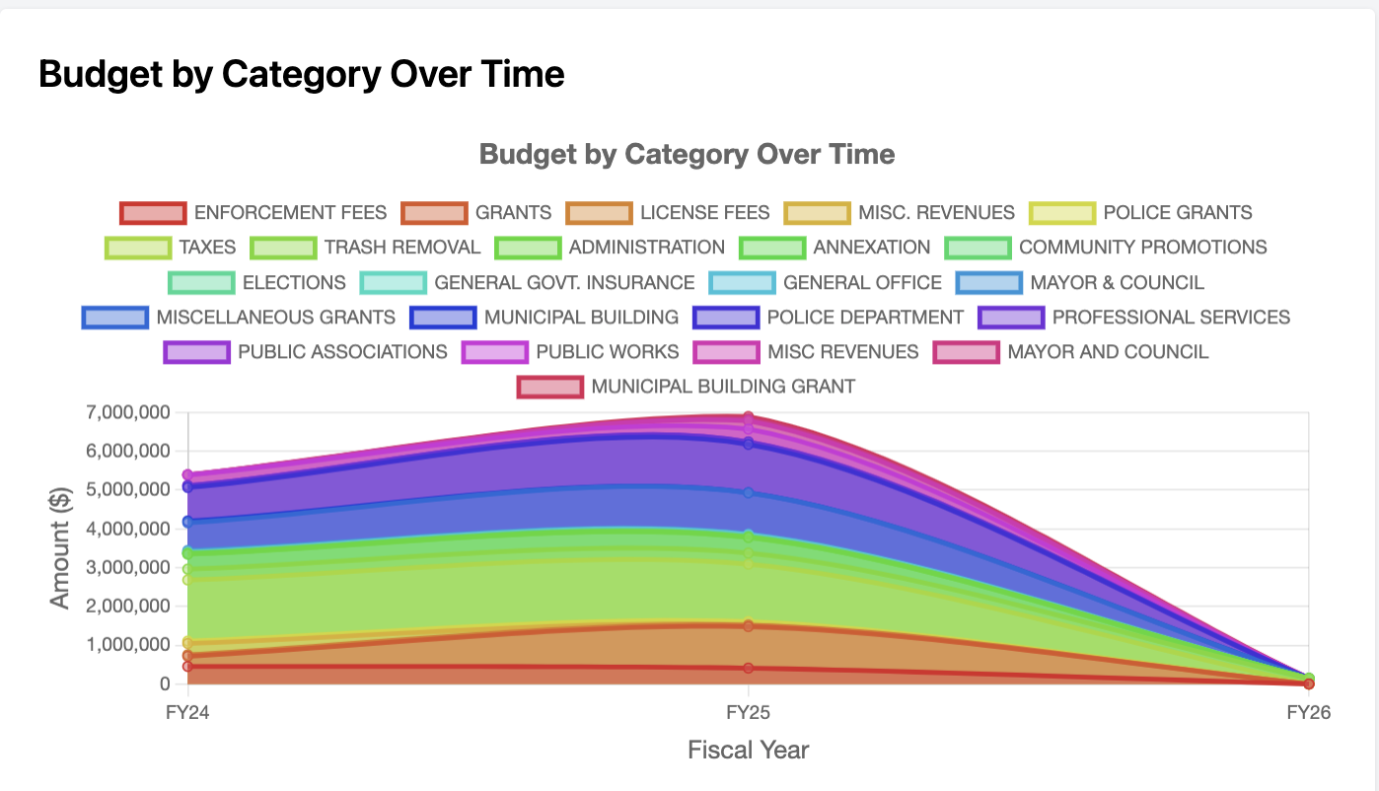
Data Dashboard
Notes:
Shishir

Slide 13
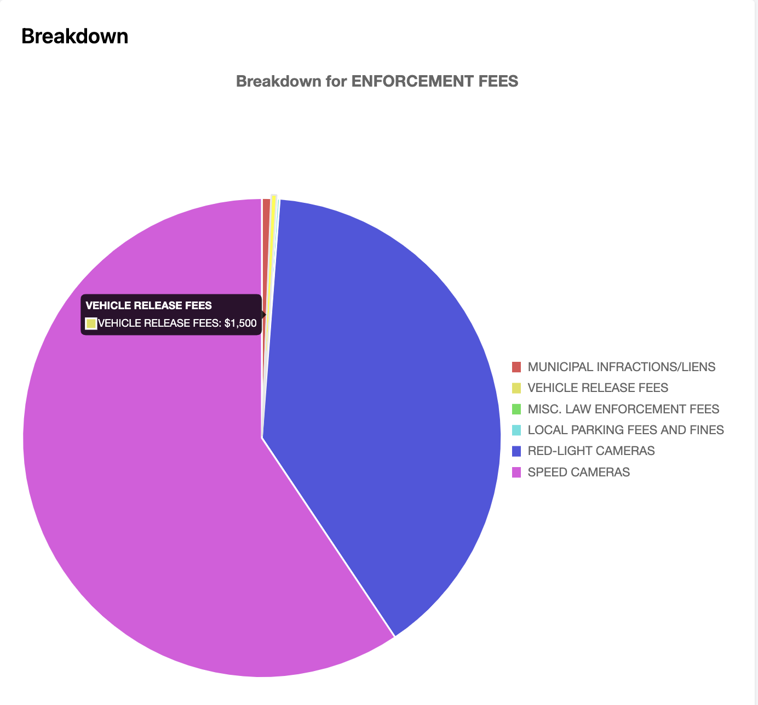
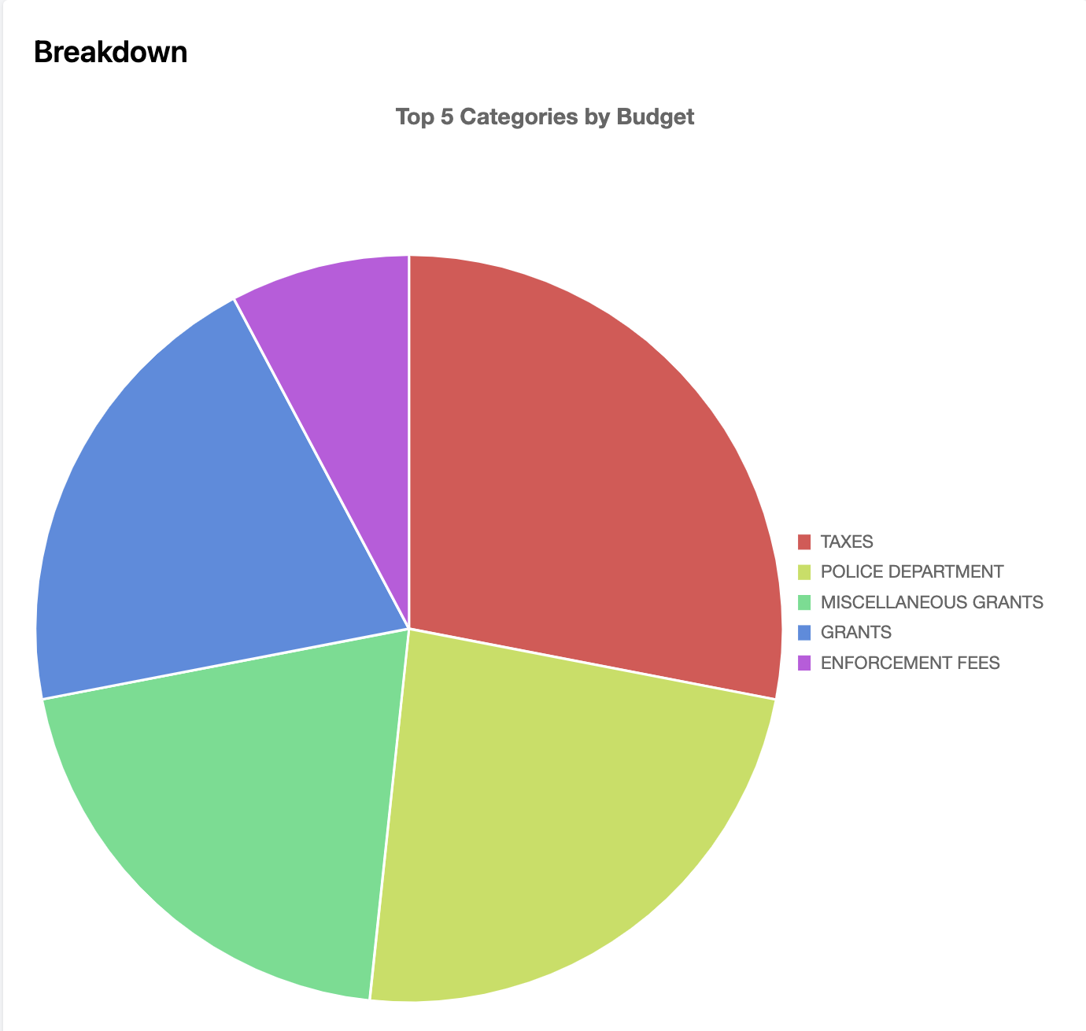
Data Dashboard
Notes:
Shishir

Slide 14
Challenges
Datasets were not available for us to view and work with in a structured format
Other municipalities contributed to the portal in ways that were not reasonably attainable for Landover Hills within the timeframe of this project
Inaccurate/Outdated contact information for representatives from Maryland Open Data Portal
Notes:
Zulykath: Throughout the semester, we ran into some challenges.
One challenge we faced was a lack of structured data. We spent a lot of time extracting data from PDF files and storing them in spreadsheet format.
Another challenge was that, although our requirements included assessing how other municipalities contributed to the portal, those methods were often not reasonable for Landover Hills to adopt. Creating an entire independent open data portal is very common for other municipalities but we could not do that for our client in the time-frame of this project.
Lastly, we faced major delays because we were unable to make contact with representatives from MD Open Data Portal. After finally making contact with them at the end of the project, we found out we had inaccurate contact information in our statement of work.

Slide 15
Recommendations
Embed data dashboard into the Landover Hills website
Find agencies within the town that can be tasked with formatting their data to be published to the Maryland Open Data Portal
Consider Future Capstone Projects for
Collecting and organizing municipal data into a centralized database
Creating a whole Data Portal for Landover Hills (Building off of our Data Dashboard)
Developing a relationship with the PG County Data Portal
Notes:
Zulykath: Taking into consideration our research and progress, we have some recommendations for the town of Landover Hills:
Firstly, embed the data dashboard into the Landover Hills Website
We also recommend finding agencies within the town that can be tasked with formatting their data in a shareable way. This way the work is distributed and does not cause any disruptions to your operations.
Lastly, we recommend participating in future Capstone projects to build on the work that we have started. These projects can have the goals of
Collecting and organizing municipal data into a centralized database
Building off our data dashboard and creating a small open data portal for the town
Developing a relationship with PG County Data Portal and find out how the town can contribute to that portal

Slide 16
Any Questions?
Notes:
Zulykath: That concludes our presentation. Are there any questions?

